Slide 1

Customer Personality Analysis Project
Ido stern
Stav atias
Niv Ben Avraham

Slide 2

Introduction
Introduction
Materials & Methods
Numerical Analysis
Conclusions
Kaggle Data Set - Dr. Omar Romero-Hernandez.
Customer Personality Analysis is a detailed analysis of a company’s ideal customers.
It helps a business to better understand its customers and makes it easier for them to modify products according to their specific needs.
Supervised learning – Classification.
Quality analysis of the data will contribute to spending less money on campaigns.

Slide 3
Material & Methods
Introduction
Materials & Methods
Numerical Analysis
Conclusions
Data
Data Cleaning
Data Preparation
Preparations For Algorithms

Slide 4
Data Cleaning
Introduction
Materials & Methods
Numerical Analysis
Conclusions
2240 Rows & 29 columns.
The data columns describe the customer in terms of year of birth, income, number of children, marital status, education, seniority, and number of purchases in the store.
Cleaning
Issue | Manipulate | Reason
Income | Deleting all income > 150000 (7 rows). | Deleting outliers.
Missing cells | Delete 24 rows. (24/2240) | Ignore missing cells.

Slide 5

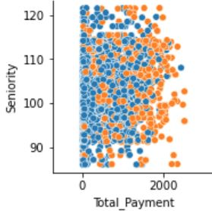
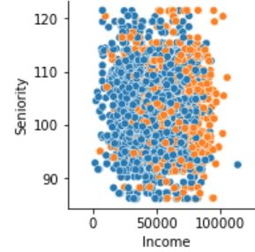
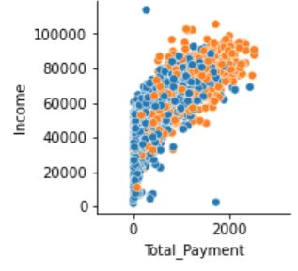
Data Preparation
Introduction
Materials & Methods
Numerical Analysis
Conclusions
Marital status
Education
Customer seniority
Total Payment
Number of transactions purchased
"Accepted_Cmp"

Slide 6
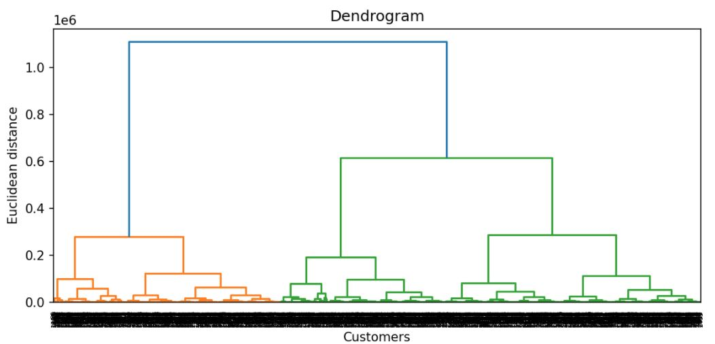
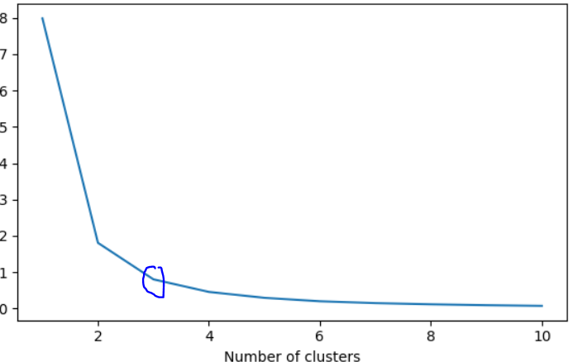
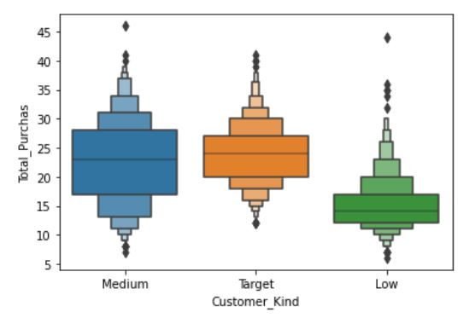
Data Preparation
Introduction
Materials & Methods
Numerical Analysis
Conclusions
Hierarchical clustering (Income, total payment, and seniority)

Slide 7
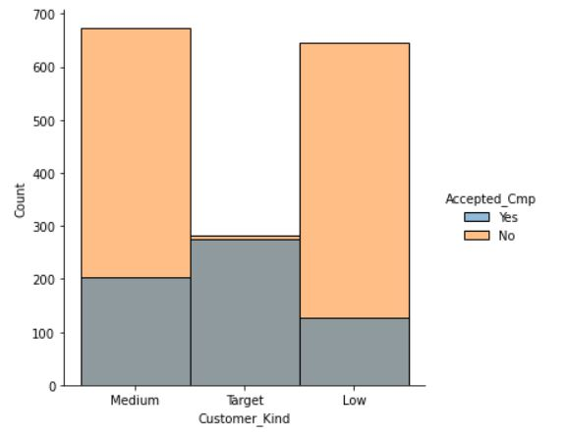
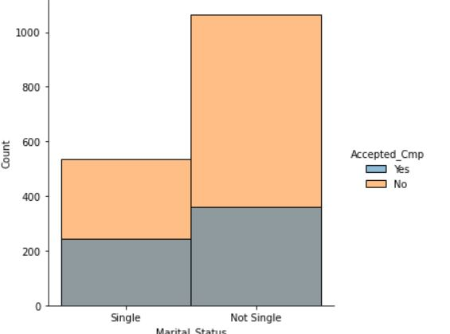
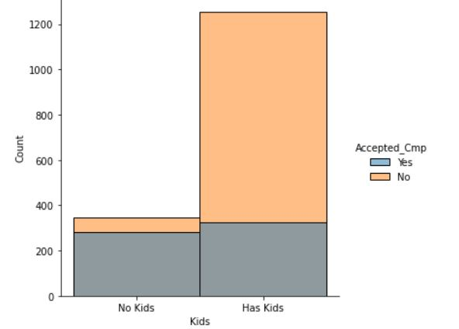

Preparations For Algorithms
Introduction
Materials & Methods
Numerical Analysis
Conclusions
Convert all the columns into a categorical data type.
The most suitable columns for predicting are:
Customer Kind: P-value = 0.003.
Marital Status: P-value = 0.01.
Kids : P-value = $1.35×{10}^{−9}$
The data split for 70% training and 30% test.
From the featues we got the indication for prediction

Slide 8
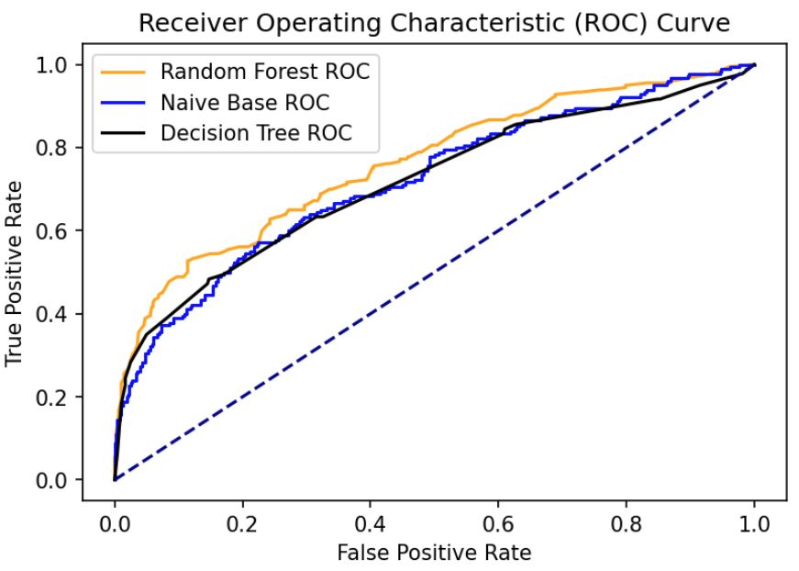
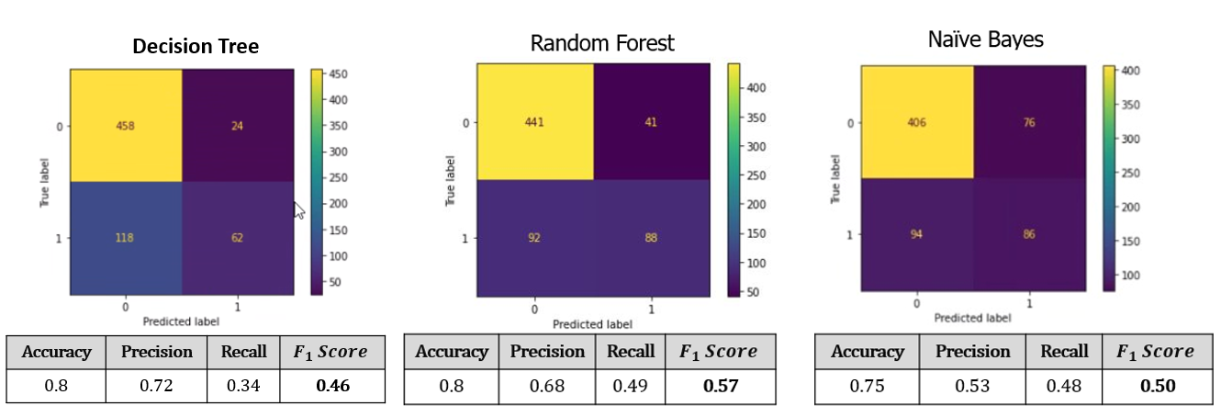
Numerical Analysis & Results
Introduction
Materials & Methods
Numerical Analysis
Conclusions
Algorithms
Roc Curve

Slide 9
Discussion
Introduction
Materials & Methods
Numerical Analysis
Conclusions
The algorithm with the best performance is Random Forest.
According to our business goal, we want to predict in the best way the customers that will accept the campaign
out of the actual number.
Our target is to get a high score in the “Recall” grade, specifically get the “FN” value to a minimum.
Another way of spending less money on campaigns is to decrease the number of customers that were labeled
as ‘Yes’ but actually, they are ‘No’(FP).

Slide 10

Conclusions
Introduction
Materials & Methods
Numerical Analysis
Conclusions
Helping the store to adjust the advertising campaigns for customers kinds.
The model gives a prediction according to 3 characteristics:
1. The customer's potential to buy
2. The marital status of the customer.
3. Customer Kids.
Customer segmentation is the key for the prediction of whether the client will accept the campaign.
focus shall be on the ‘Recall’ grade and try to reach the perfect score of ‘1’.

Slide 11

Thank You !

